Slide 1
Module 5: Sampling
5.7: Cluster sampling
Annie Collins
Data Sciences Institute, University of Toronto

Slide 2
Learning Outcomes
How might our study be impacted if we sample entire groups of individuals from our population based on shared characteristics? How do we effectively study a sample selected in this manner?
Identify benefits of using cluster sampling
Compute sample statistics for cluster samples
Design a study using cluster sampling
Distinguish between different types of cluster sampling, and between cluster sampling and stratified sampling

Slide 3
What is cluster sampling?

Slide 4
Cluster Sampling
Divide the whole population into non-overlapping subpopulations based on shared characteristics. These subpopulations are called clusters.
Randomly select a sample of clusters.
Survey every individual unit within each sampled cluster.

Slide 5
Sampling Units
Primary sampling units (PSUs)
Groupings in the first iteration of sampling – in this case, clusters
Secondary sampling units (SSUs)
Individuals units who are selected and/or surveyed directly
Also known as the observational units
Observational units are only included in the sample if they belong to the sampled PSU (cluster)

Slide 6
Why use cluster sampling?
It may be difficult, expensive, or impossible to create a sampling frame of individual (non-clustered) sampling units
For example, all birds in a forest or all individuals in a city at a given time
Population may occur in natural or pre-existing clusters
For example, households or schools
For geographically widespread populations, sampling by cluster reduces the chance of extensive travel to reach a single individual

Slide 7
Why not use cluster sampling?
Decreased precision
SSUs in each cluster tend to share similar characteristics
More difficult to generalize to population-level estimates

Slide 8
Cluster sampling versus stratified sampling
Both are non-overlapping subpopulations for a given population
Clusters are often defined for convenience, while strata may be defined to benefit particular types of analysis
Sampling procedure is different
Stratified sampling: define strata → sample within each stratum → survey/observe units in the samples
Cluster sampling: define clusters → sample a subset of clusters → survey/observe all units in each sampled cluster

Slide 9
Based on Lohr, 2019, Figure 5.1
Stratified Sampling
Cluster Sampling

Slide 10
One-Stage Cluster Sampling

Slide 11
One-Stage Cluster Sampling
A random subset of PSUs (clusters) is sampled, and all SSUs within each sampled PSU are measured
Used when the cost of measuring SSUs is small compared with the cost of sampling PSUs

Slide 12
Clusters of Equal Sizes: Notation
Let N represent the total number of PSUs. Let n represent the number of sampled PSUs. Let t_{i} represent the total for all elements in PSU i.
Let M represent the number of people in each cluster. In one stage cluster sampling with samples of equal size, M = M_{i} = m_{i} for all i.
Interpretation: The number of people in each cluster (M_{i}) is the same for all clusters, and all units from each sampled cluster are measured (m_{i})

Slide 13
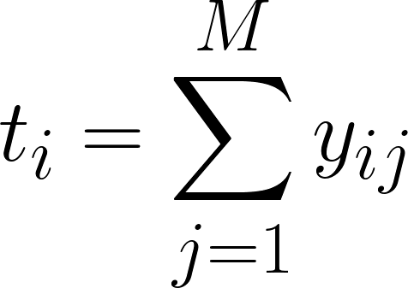
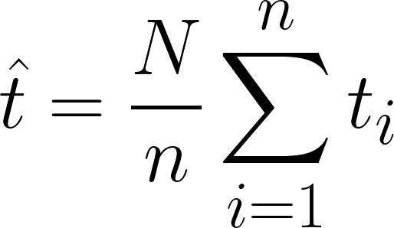
Clusters of Equal Sizes: PSU Total
Let x_{ij} represent the measurements from SSU (observational unit) j within PSU (cluster) i. The total measurement within PSU i is,
The total across all PSUs can be estimated with,
This is a weighted sum of the total measurements from each individual cluster.

Slide 14
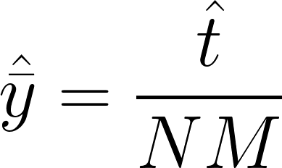


Clusters of Equal Sizes: Sample Mean
To estimate the average per SSU (observational unit), divide the estimated total by the total number of SSUs:
is an estimator for the sample mean . Since the calculation involves the estimator for the population total, this is not a direct calculation of the sample mean.

Slide 15
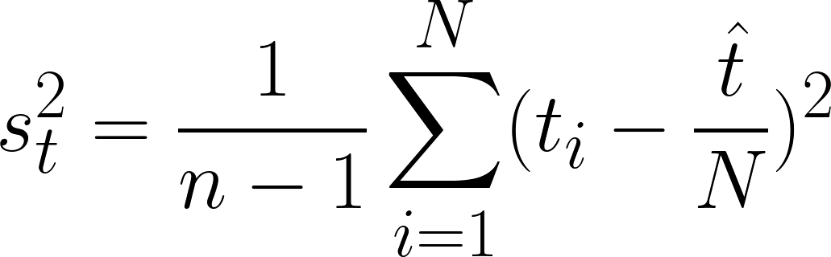
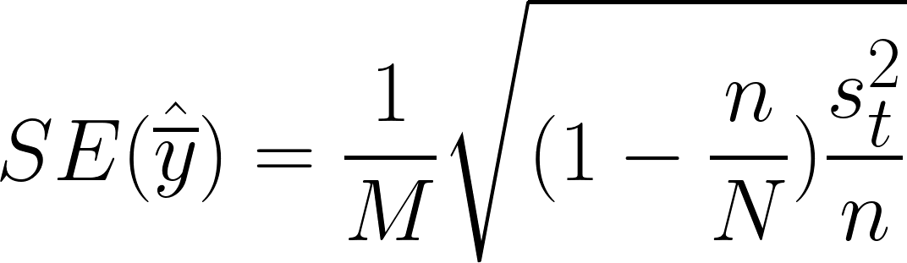
Clusters of Equal Sizes: Sample Variance
The sample variance of the PSU totals is,
s_{t}² can then be used to compute the standard error of the estimated sample mean:

Slide 16
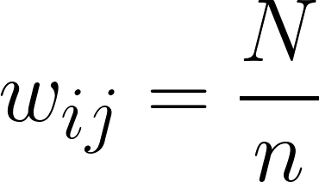
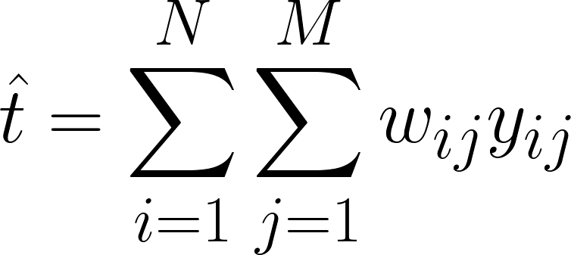
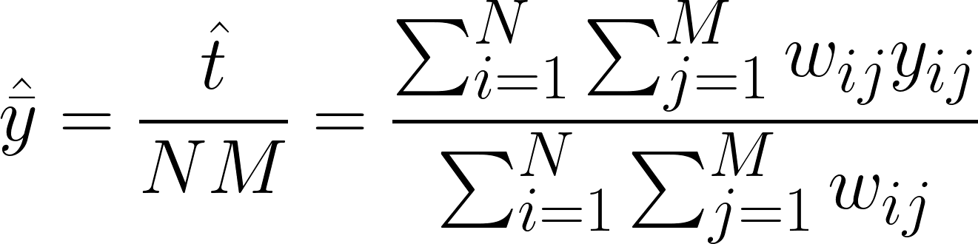
Clusters of Equal Sizes: Weights
One-stage cluster sampling with clusters of equal sizes produces a self-weighting sample, with weights,
These weights can be used to estimate the sample total and mean directly from SSU measurements x_{ij} :

Slide 17
Clusters of Unequal Sizes: Notation
The definitions for n, N, and t_{i} are the same as previously.
Let M_{i} represent the number of people in PSU (cluster) i. For clusters of unequal sizes, it is now possible that M_{i} ≠ M_{j} for i ≠ j.
One-stage sampling means that m_{i} = M_{i} still (all SSUs in each cluster are sampled).

Slide 18


Clusters of Unequal Sizes: SSU Total
The total number of SSUs in the population is defined as,
This can be computed directly when the size of every PSU is known. However, this is not always possible. M₀ can thus be estimated:

Slide 19
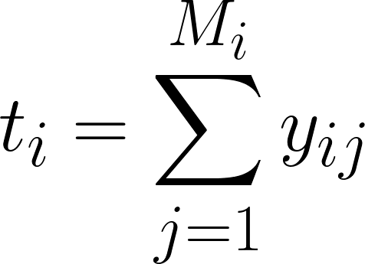
Clusters of Unequal Sizes: PSU Total
The total within each PSU can be estimated nearly the same way as for clusters of equal sizes, with the difference that M_{i} may be different for different clusters:
The total across all PSUs can be estimated with,
This is the same as for clusters of equal sizes.

Slide 20
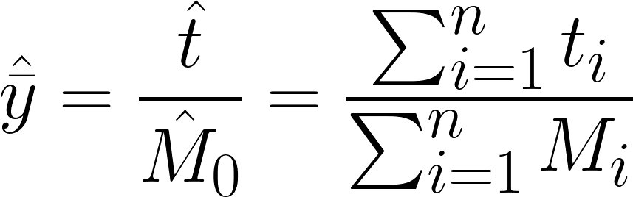
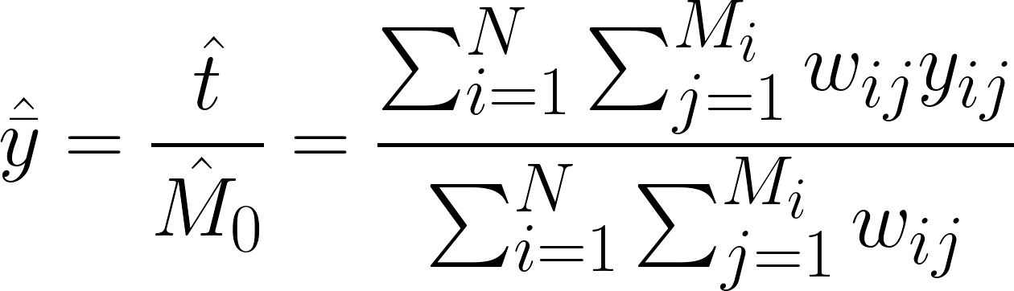
Clusters of Unequal Sizes: Sample Mean
The sample mean can be calculated using the estimates for t and M₀ :
This can also be calculated using weights, with the same weights and calculation as for clusters of equal sizes:

Slide 21
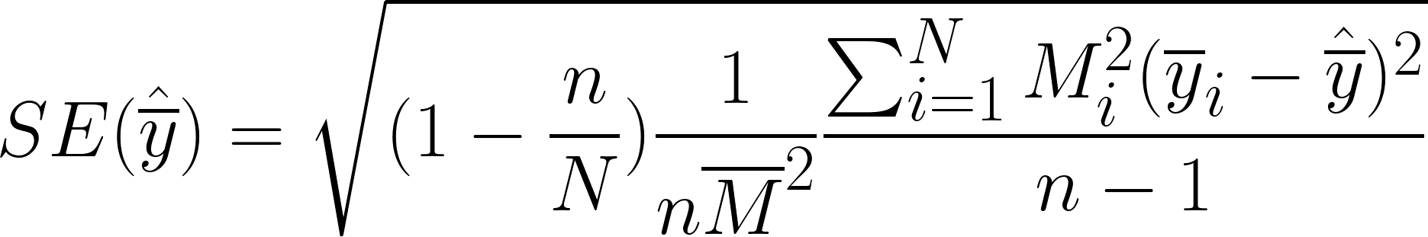


Clusters of Unequal Sizes: Sample Mean Variance
The standard error for the sample mean can be estimated as follows,
where represents the sample mean within PSU i and represents the mean number of SSUs in each PSU.

Slide 22
Two-Stage Cluster Sampling

Slide 23
Two-Stage Cluster Sampling
A random subset of PSUs (clusters) is selected, and then a random sample of the SSUs (observational units) within each PSU is selected for observation.
Two stage sampling might be used if:
The cost of sampling SSUs is relatively high compared with the cost of sampling PSUs
Elements in a cluster are very similar to each other

Slide 24
Based on Lohr, 2019, Figure 5.2
One-Stage
Measure all SSUs within each sampled PSU
Randomly select n PSUs
Two-Stage
Randomly select SSUs within each sampled PSU
Randomly select n PSUs

Slide 25

Two-Stage Cluster Sampling: Selection Probability
Since sampling is occurring at two different stages now, the selection probability of y_{ij} (the j^{th} SSU in PSU i) is a combination of the probability of PSU i being selected, and the probability of SSU j being selected within PSU i. Assuming an SRS is taken at both stages, we have:
𝜋_{ij} = P(j^{th} SSU in i^{th} PSU selected)
= P(i^{th} PSU selected) x P(j^{th} SSU selected | i^{th} PSU selected)
=

Slide 26

Two-Stage Cluster Sampling: Weights
As always, the weight of observational unit y_{ij} is the reciprocal of its selection probability.
If m_{i}/M_{i} is approximately constant for all PSUs (i.e. a proportional sample from all clusters), this is considered a self-weighting sample.

Slide 27
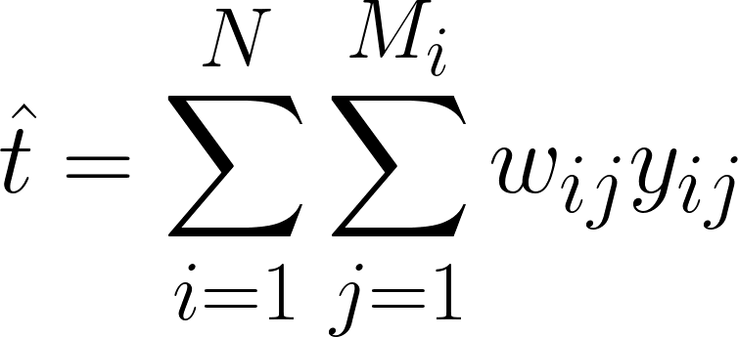
Two-Stage Cluster Sampling: Population Total
The population total can be estimated in the same was as one-stage cluster sampling.

Slide 28
Two-Stage Cluster Sampling: Sample Mean
The sample mean can be calculated using the estimates for t and M₀ . This is much the same as in one-stage cluster sampling, except the totals for each PSU must now be estimated as well:
This can also be calculated using weights, with the same weights and calculation as for one-stage sampling:

Slide 29
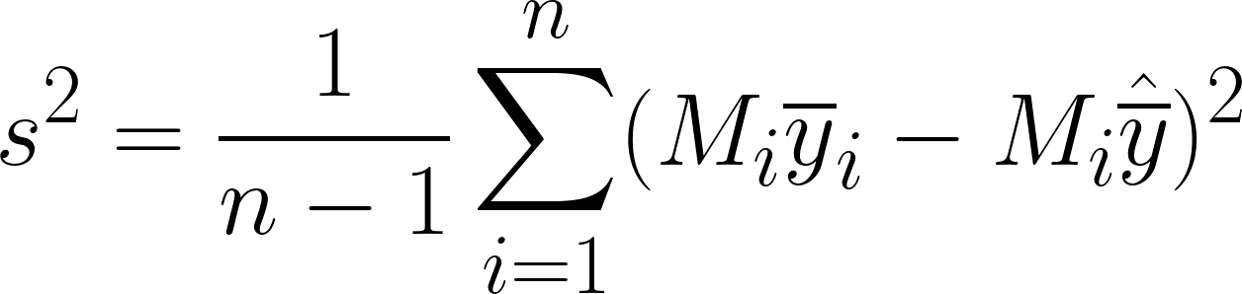
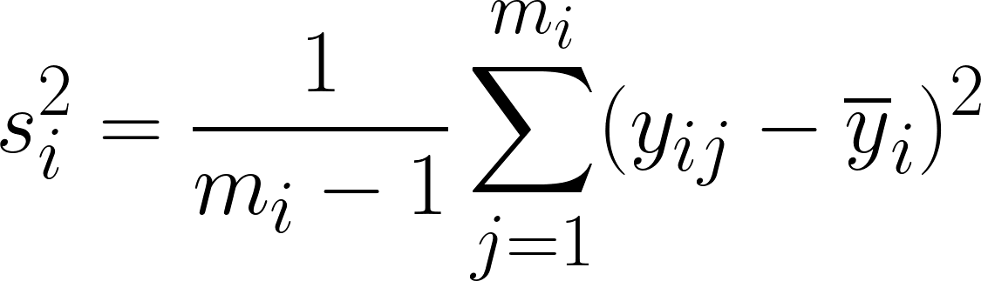
Two-Stage Cluster Sampling: Sample Variance
With two-stage sampling, there are two types of variance: between PSUs, and within PSUs. Both calculations follow a familiar structure.
The variance between PSUs can be calculated,
The variance within PSU i can be calculated,

Slide 30
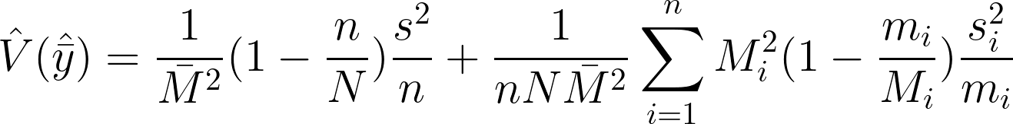
Two-Stage Cluster Sampling: Estimator Variance
The estimated variance of the sample mean is also comprised of variance within and between PSUs,
where s² and s_{i}² are defined as previous, and is the average PSU size.

Slide 31
Designing a Cluster Sample

Slide 32
Choosing a PSU Size
Often will come about naturally
There may be pre-existing groupings that can be used as clusters
Examples: classrooms, farms, stores
Larger PSU size means larger variability within a PSU
PSUs that are too large or too small may reduce cost saving benefits of cluster sampling

Slide 33
Choosing a Sub-Sample Size (m_{i})
Considerations
Cost
Is measuring more SSUs marginally expensive or inexpensive?
Accessibility
Do you have access to all SSUs in a given PSU? How difficult is it to measure more SSUs?
Homogeneity
Are all the SSUs in a given PSU relatively similar? How much more information is gained by measuring more SSUs?
In general, the same considerations as a general also SRS apply.

Slide 34
Choosing a Sample Size (n)
This process is similar to selecting sample sizes for SRS.
Determine precision needed.
Propose PSU and sub-sample sizes.
Calculate the variance that will be achieved.
Choose n to achieve desired precision.
Iterate until n is realistic given available resources.

Slide 35
Systematic Sampling (again)

Slide 36
Systematic Sampling
Recall that systematic sampling involves obtaining a list of population units, selecting a sample size n, a selection interval k, and a starting point R, and then sampling elements R, R + k, R + 2k and so on.
Within a population, the subpopulations {R, R + k, R + 2k…} form clusters for different values of R.
By selecting a random R between 1 and n, we are sampling one cluster.
Analysis of systematic samples is often similar to SRS. See 5.5: Simple probability samples for details.

Slide 37
Next
5.8 Non-response

